Slide 1
COMPULSORY BREIFING SESSION
FOR THE SUPPLY AND INSTALLATION OF BULK ELECTRICAL SUPPLY INCLUDING TRANSFORMERS, SWITCHGEARS, MCC AND SUB-STATION BUILDINGS AT SALDANHA BULK TERMINAL FOR TRANSNET SOC LTD (REG.NO.1990/000900/30) OPERATING AS TRANSNET PORT TERMINALS, (HEREINAFTER REFERRED TO AS “TPT”)
Presented By: Hlengiwe Zulu
Notes:
Growth and Reinvent

Slide 2
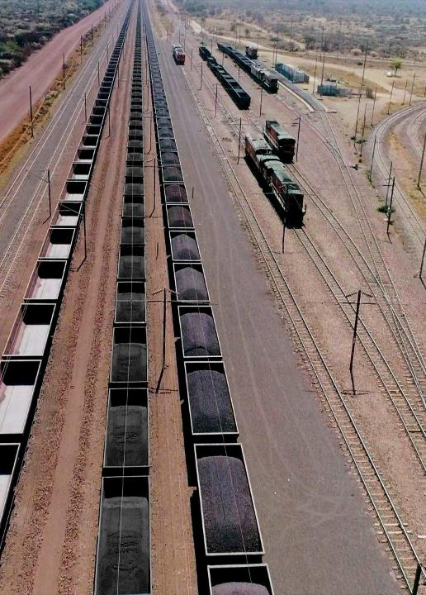
AGENDA
Agenda Point | Time Allocated | Presenter
Safety | 5 minutes | Safety Representative
Welcome and introduction | 2 minutes | Hlengiwe Zulu
Session rules of engagement | 5 minutes | Hlengiwe Zulu
Procurement process briefing | 10 minutes | Hlengiwe Zulu
SD – Transformational objectives | 10 minutes | Nandipha Ngcobo
Technical Scope & requirements | 30 minutes | Willie Van Dyk /Clarence King
Questions and closing/Site Visit | 20 minutes | Willie Van Dyk/Clarence King / Hlengiwe Zulu
2

Slide 3
SESSION RULES OF ENGAGEMENT (1/2)
This briefing session is compulsory
Attendance register and Certificate of attendance
Bidders are requested to remain for the entire duration of the briefing session as important information pertaining to the RFP will be presented.
An opportunity for Clarification questions will be provided after the briefing session
Any additional clarification questions hereafter will only be accepted by TPT until 15h00 on Friday, 05 April 2024.
All communication subsequent to this briefing session must only be directed to Hlengiwe Zulu Hlengiwe.Zulu@transnet.net
After the closing date of the RFP, a Respondent may only communicate with the name of delegated individual (BEC chairperson), at telephone number, email on any matter relating to its RFP Proposal
A copy of this presentation will be provided to all bidders whose attendance has been confirmed by Transnet and loaded onto the Transnet e-tenders portal and National Treasury

Slide 4
TENDER PROCESS: CONTENTS OF THE RFP
The tender documents issued by the employer comprise:
The Tender
Part T1: Tendering procedures
T1.1 Tender Notice and Invitation to Tender
T1.2 Tender data
Part T2: Returnable documents
T2.1 List of Returnable Documents
T2.2 Returnable Schedules
The Contract
Part C1: Agreements and contract data
C1.1 Forms of offer and acceptance
C1.2 Contract data (part 1 & 2)
C1.3 Forms of Securities
Part C2: Pricing data
C2.1 Pricing Instructions
C2.2 Bill of Quantities
Part C3: Scope of work
C3.1 Scope of Services

Slide 5
T1.1 TENDER NOTICE AND INVITATION TO TENDER
For the supply and installation of Bulk Electrical supply including Transformers, Switchgears, MCC and sub-station buildings at Saldanha Bulk Terminal for Transnet Soc Ltd (reg.no.1990/000900/30) operating as Transnet Port Terminals, (hereinafter referred to as “TPT”).
A Compulsory Tender Clarification Meeting- Tenderers are required to bring this Returnable Schedule T2.2-01 to the Compulsory Tender Clarification Meeting to be signed by the Employer’s Representative.
Tender Closing Date- 12:00pm on (12 April 2024), If a tender is late, it will not be accepted for consideration.

Slide 6
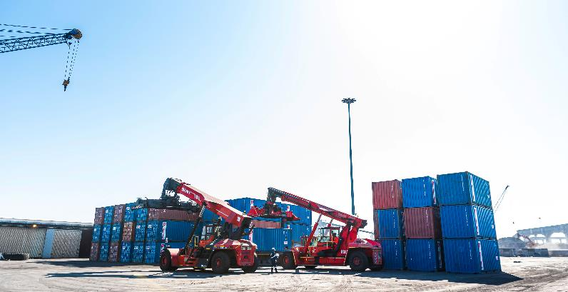
TENDER SUBMISSION
The Transnet e-Tender Submission Portal can be accessed as follows:
Log on to the Transnet eTenders management platform website
(https://transnetetenders.azurewebsites.net);
▪ Click on “ADVERTISED TENDERS” to view advertised tenders;
▪ Click on “SIGN IN/REGISTER – for bidder to register their information (must fill in all
mandatory information);
▪ Click on “SIGN IN/REGISTER” - to sign in if already registered;
▪ Toggle (click to switch) the “Log an Intent” button to submit a bid;
▪ Submit bid documents by uploading them into the system against each tender selected

Slide 7
TENDER SUBMISSION
Tenderers are required to ensure that electronic bid submissions are done at least a day before the closing date to prevent issues which they may encounter due to their internet speed, bandwidth or the size of the number of uploads they are submitting. Transnet will not be held liable for any challenges experienced by bidders as a result of the technical challenges. Please do not wait for the last hour to submit. A Tenderer can upload 30mb per upload and
multiple uploads are permitted.

Slide 8
T1.2 TENDER DATA
EVALUATION METHODOLOGY
STAGE 1: PREQUALIFICATION
STAGE 2
STAGE 3
Step 1
Step 2
Step 3
Step 4
Step 5
Step 6
Administrative responsiveness
Substantive responsiveness
MINIMUM THRESHOLDS
Returnable documents/ schedules
Functionality/ technical**
70 points
Minimum Threshold
Weighted scoring / 100***
Pre-qualification
Post tender negotiation with preferred bidder [2nd and 3rd ranked bidders (if required) in a sequential and not simultaneous manner] if pricing is not market-related
Price (90)
B-BBEE scorecard (10)
Award of business and conclusion of contract
WEIGHTED SCORE
Technical / Functional criteria & weightings must be stipulated in the tender document

Slide 9
Evaluation Methodology
Step One: Administrative responsiveness
Whether the bid has been lodged on time.
Whether all Returnable Documents and/or schedules were completed and returned by the closing date and time.
Verify the validity of all Returnable Documents.
Step Two: Substantive responsiveness
Whether any general pre-qualification criteria set by Transnet, have been met. i.e., Proof of attendance of the compulsory briefing session, CIDB grading and technical prequalification
Whether the Bid contains a Financial offer.
Whether the Bid materially complies with the scope and/or specification given

Slide 10
Evaluation Methodology
Only those tenderers who satisfy the following eligibility criteria are eligible to submit
tenders:
Stage One - Eligibility with regards to attendance at the compulsory
clarification meeting:
An authorised representative of the tendering entity or a representative of a tendering entity that intends to form a Joint Venture (JV) must attend the compulsory clarification meeting in terms C2.7

Slide 11
Evaluation Methodology
Stage Two - Eligibility in terms of the Construction Industry Development Board:
Only those tenderers who are registered with the CIDB, or are capable of being so prior to the evaluation of submissions, in a contractor grading designation equal to or higher than a contractor grading designation determined in accordance with the sum tendered or a value determined in accordance with Regulation 25 (1B) or 25(7A) of the Construction Industry Development Regulations, designation of 9 EP class of construction work, are eligible to have their tenders evaluated.

Slide 12
Evaluation Methodology
Stage Two - Eligibility in terms of the Construction Industry Development Board:
Joint Venture (JV)
Joint ventures are eligible to submit tenders subject to the following:
every member of the joint venture is registered with the CIDB;
the lead partner has a contractor grading designation of not lower than one level below the required class of construction works under consideration and possesses the required recognition status; and
the combined Contractor grading designation calculated in accordance with the Construction Industry Development Regulations is equal to or higher than a Contractor grading designation determined in accordance with the sum tendered for a 9 EP class of construction work or a value determined in accordance with Regulation 25(1B) or 25(7A) of the Construction Industry Development Regulations
The tenderer shall provide a certified copy of its signed joint venture agreement

Slide 13
Evaluation Methodology
Stage Two - Eligibility in terms of the Construction Industry Development Board:
It is estimated that tenderers should have a CIDB contractor grading of 9EP. 8EP potentially emerging enterprises who satisfy criteria stated in the Tender Data may submit tender offers.

Slide 14
Evaluation Methodology
Stage Three - Technical Eligibility - Professional Registration
The tenderer to submit all active professional registration certificates for all key engineering personnel with Engineering Council of South Africa (ECSA), or Washington Accord Equivalent. Curriculum Vitae to be submitted to demonstrate relevant experience in line with professional registration.

Slide 15
Evaluation Methodology
Stage Four - Functionality:
Only those tenderers who obtain the minimum qualifying score for functionality will be evaluated further in terms of price and the applicable preference point system. The minimum qualifying for score for functionality is 70 points.
The evaluation criteria for measuring functionality and the points for each criteria and, if any, each sub-criterion are as stated in C3.11
Any tenderer that fails to meet the stipulated pre-qualifying criteria will be regarded as an unacceptable tender.

Slide 16
Evaluation Methodology
Stage Five : Evaluation and Final Weighted Scoring
Only tenders that achieve the minimum qualifying score for functionality will be evaluated further in accordance with the 90/10 preference points systems as described in Preferential Procurement Regulations.
Evaluation Criteria | Final Weighted Scores
Price | 90
Specific goals - Scorecard | 10
TOTAL SCORE: | 100

Slide 17
NEC ECC APPLICABLE CLAUSES
B: Priced contract with bill of quantities
W1: Dispute resolution procedure
X1: Price adjustment for inflation
X2: Changes in the law
X5: Sectional Completion
X7: Delay damages
X13: Performance Bond
X16: Retention
X18: Limitation of liability
Z: Additional conditions of contract

Slide 18
CLOSING DATE AND TIME
The closing time for submission of tender offers is:
Time: 12:00pm on the 12 April 2024
Location: The Transnet e-Tender Submission Portal: (https://transnetetenders.azurewebsites.net);

Slide 19
Thank you

